Slide 1
The August 2022 Chemistry Regents
The answers follow the questions…
The answers are in red. Blue and black is for thinking.

Slide 2
1 What is the number of protons in an atom with the electron configuration of 2-5? (1) 5 (2) 2 (3) 3 (4) 7

Slide 3
1 What is the number of protons in an atom with the electron configuration of 2-5? (1) 5 (2) 2 (3) 3 (4) 7 The element with a 2-5 configuration is nitrogen (#7). Nitrogen has an atomic number of 7, which means it has 7 protons that are positive.
It also has to have 7 negative electrons. It’s mass rounds to 14, which means a total of 14 protons PLUS neutrons. 14 total – 7 protons = leaves 7 neutrons. Electrons have no mass in HS.

Slide 4
2 In the wave-mechanical model of an atom, an orbital is defined as (1) a region of the most probable neutron location (2) a region of the most probable electron location (3) the straight-line path of a neutron (4) the straight-line path of an electron

Slide 5
2 In the wave-mechanical model of an atom, an orbital is defined as (1) a region of the most probable neutron location (2) a region of the most probable electron location (3) the straight-line path of a neutron (4) the straight-line path of an electron The modern model is called wave mechanical, because the electrons seem to act as both waves of energy and mechanical bits of negatively charged matter, at the same time. Neutrons are ALWAYS inside of the nucleus. Orbitals are where the electrons live, outside the nucleus.

Slide 6
3 In the ground state, which shell of a potassium atom has an electron with the greatest amount of energy? (1) first (2) second (3) third (4) fourth

Slide 7
3 In the ground state, which shell of a potassium atom has an electron with the greatest amount of energy? (1) first (2) second (3) third (4) fourth K has an electron orbital of 2-8-8-1 The electrons closer to the nucleus, are of lower energy. The further from the nucleus the more energy they have (the wilder they are! So to speak)

Slide 8
4 Which phrase describes two atoms that contain the same number of protons but a different number of neutrons? (1) ions of the same element (2) isotopes of the same element (3) a mixture of different elements (4) nuclides of different elements

Slide 9
4 Which phrase describes two atoms that contain the same number of protons but a different number of neutrons? (1) ions of the same element (2) isotopes of the same element (3) a mixture of different elements (4) nuclides of different elements For example, all atoms of uranium have 92 protons. They all have the SAME atomic number. An isotope is an atom with a different number of neutrons but is the same KIND of atom.

Slide 10
5 All atoms of an element have the same (1) mass number (2) atomic mass (3) number of neutrons (4) number of protons

Slide 11
5 All atoms of an element have the same (1) mass number (2) atomic mass (3) number of neutrons (4) number of protons This is near identical to the last question. All atoms of one element have to have the same atomic number, or number of protons. Mass number, atomic mass, and neutrons change, that is what isotopes are: chemically identical atoms with different numbers of neutrons (and therefore a different mass)

Slide 12
6 Which Group 15 element is classified as a metal? (1) N (2) P (3) As (4) Bi

Slide 13
6 Which Group 15 element is classified as a metal? (1) N (2) P (3) As (4) Bi Fingers in the box time. N is on the right side of the stairs = nonmetal P is on the right side of the stairs = nonmetal As is on the right side of the stairs = nonmetal Bi is on the LEFT side of the stairs = metal The only exception to this “rule of the stairs” is hydrogen (the freak)

Slide 14
7 Compared to the number of electron shells and radius of an aluminum atom in the ground state, a boron atom in the ground state has (1) fewer electron shells and a smaller radius (2) fewer electron shells and a larger radius (3) more electron shells and a smaller radius (4) more electron shells and a larger radius

Slide 15
7 Compared to the number of electron shells and radius of an aluminum atom in the ground state, a boron atom in the ground state has (1) fewer electron shells and a smaller radius (2) fewer electron shells and a larger radius (3) more electron shells and a smaller radius (4) more electron shells and a larger radius Make a table now… WRITE what the table says Boron has fewer shells and a smaller radius. Don’t try this in your head.
 | Number of shells or orbitals | Radius in pm
Al | 3 | 124
B | 2 | 84

Slide 16
8 Hydrogen sulfide, H₂S, is classified as a (1) compound with atoms in a fixed proportion (2) compound with atoms in a proportion that can vary (3) mixture with atoms in a fixed proportion (4) mixture with atoms in a proportion that can vary

Slide 17
8 Hydrogen sulfide, H₂S, is classified as a (1) compound with atoms in a fixed proportion (2) compound with atoms in a proportion that can vary (3) mixture with atoms in a fixed proportion (4) mixture with atoms in a proportion that can vary Compounds have set formulas, or ratios that are fixed. Mixtures have 2 or more substances NOT BONDED together. With a formula, you are a compound. The H and S are BONDED together, not mixed.

Slide 18
9 A structural formula differs from a molecular formula in that a structural formula shows the (1) arrangement of atoms (2) number of atoms (3) ratio of atoms (4) types of atoms

Slide 19
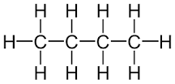
9 A structural formula differs from a molecular formula in that a structural formula shows the (1) arrangement of atoms (2) number of atoms (3) ratio of atoms (4) types of atoms The structural formula is for “seeing how a molecule is built”. Molecular formulas are for counting and molar mass math. Ratios could be in molecular (or dumb empirical formulas)
Let’s use butane for an example here, to help you think.
Structural formula Molecular formula C₄H₁₀

Slide 20
10 Which type of reaction occurs when a compound is separated into its elements? (1) synthesis (2) decomposition (3) single replacement (4) double replacement

Slide 21
10 Which type of reaction occurs when a compound is separated into its elements? (1) synthesis (2) decomposition (3) single replacement (4) double replacement Synthesis combines smaller reactants into a larger compound. Decomp it is. One larger reactant breaks down into smaller products.
Single Replacement switches in an atom for an ion in solution.
Double Replacement does the double switch with 2 AQ solutions

Slide 22
11 Which terms represent two categories of compounds? (1) chemical and physical (2) chemical and molecular (3) ionic and physical (4) ionic and molecular

Slide 23
11 Which terms represent two categories of compounds? (1) chemical and physical (2) chemical and molecular (3) ionic and physical (4) ionic and molecular Chemical and physical refer to “changes”. A reaction or a phase change.
NaCl and CH₄ are ionic and molecular compound examples.

Slide 24
12 When an atom of hydrogen and an atom of chlorine combine to form a molecule of hydrogen chloride, a bond is (1) formed as energy is absorbed (2) formed as energy is released (3) broken as energy is absorbed (4) broken as energy is released

Slide 25
12 When an atom of hydrogen and an atom of chlorine combine to form a molecule of hydrogen chloride, a bond is (1) formed as energy is absorbed (2) formed as energy is released (3) broken as energy is absorbed (4) broken as energy is released H + Cl → HCl (imagining single atoms instead of diatomic molecules of H₂ and Cl₂)
A bond between H and Cl has to form.
When bonds form, energy is released. (this has to be memorized)

Slide 26
13 All atoms of the element vanadium must have the same (1) atomic number (2) mass number (3) number of neutrons plus electrons (4) number of protons plus neutrons

Slide 27
13 All atoms of the element vanadium must have the same (1) atomic number (2) mass number (3) number of neutrons plus electrons (4) number of protons plus neutrons We saw this question earlier twice! All atoms of any element have the same number of protons which means the same atomic number.
Neutrons change so neutrons + electrons or neutrons + protons changes with new isotopes.
Mass changes too with isotopes, each neutron is 1 AMU, different isotopes = different masses.

Slide 28
14 Which sample of matter can be separated into two different substances by physical means? (1) liquid bromine (2) gaseous propane (3) solid sodium acetate (4) aqueous magnesium sulfate

Slide 29
14 Which sample of matter can be separated into two different substances by physical means? (1) liquid bromine >>> this is an element (2) gaseous propane >>> this is a compound (3) solid sodium acetate >>> this is a compound (4) aqueous magnesium sulfate >>> this is a mixture Pure matter, elements and compounds are not mixed. Elements are the simplest of the pure substances and cannot be broken down at all. Compounds can be chemically broken down into elements. An aqueous solution is water with stuff mixed into it. Here, the water can be evaporated away, separating the water from the MgSO _{(S)}

Slide 30
15 Two liquids can be separated by distillation due to a difference in (1) concentration (2) conductivity (3) boiling point (4) heat of fusion

Slide 31
15 Two liquids can be separated by distillation due to a difference in (1) concentration (2) conductivity (3) boiling point (4) heat of fusion Concentration is how much stuff is present in solution. Conductivity means how well a substance can conduct either heat or electricity (or sound, etc.), and heat of fusion means how many joule of energy it takes to either melt or freeze one gram of this stuff at it’s freezing point.
Separating a mixture by difference in boiling point is called distillation.

Slide 32
16 Which unit can be used to express the concentration of a PbCl₂(aq) solution? (1) kelvins (2) kilojoules per gram (3) pascals (4) parts per million

Slide 33
16 Which unit can be used to express the concentration of a PbCl₂(aq) solution? (1) kelvins (2) kilojoules per gram (3) pascals (4) parts per million Put your finger into the “concentration” box on the back page of the reference table S now. Molarity is much more common, but for especially weak solutions, PPM is also used. Kelvin is temperature, kJ/gram is energy per gram and is NOT on the reference tables. Pascals is pressure, as kilopascals or kPa.

Slide 34
17 Compared to the freezing point and boiling point of water at 1.0 atm, a 0.5 M aqueous solution of NaCl at 1.0 atm has (1) a lower freezing point and a lower boiling point (2) a lower freezing point and a higher boiling point (3) a higher freezing point and a lower boiling point (4) a higher freezing point and a higher boiling point

Slide 35
17 Compared to the freezing point and boiling point of water at 1.0 atm, a 0.5 M aqueous solution of NaCl at 1.0 atm has (1) a lower freezing point and a lower boiling point (2) a lower freezing point and a higher boiling point (3) a higher freezing point and a lower boiling point (4) a higher freezing point and a higher boiling point Make a chart, write what you find. SAY: the NaCl solution has… The FP and BP are known for pure water. Whenever stuff is dissolved into water, there are changes to colligative properties like FP and BP. Here the freezing point is depressed, and the boiling point is elevated.
 | Freezing point | Boiling point
Water | 273 K or 0°C | 373 K or 100°C
NaCl_{(AQ)} | Lower | Higher
Impact | 1.86°C/mole particles dissolved per liter | 0.5°C/mole particles dissolved per liter

Slide 36
18 Which form of energy is converted to thermal energy when propane burns in air? (1) chemical (2) electrical (3) mechanical (4) nuclear

Slide 37
18 Which form of energy is converted to thermal energy when propane burns in air? (1) chemical (2) electrical (3) mechanical (4) nuclear Chemical energy (energy stored in the bonds is converted into heat energy when combustion occurs. Propane is a hydrocarbon, combining with oxygen in the air, it forms water and carbon dioxide gases. ΔH is negative, energy is a product.

Slide 38
19 According to the kinetic molecular theory, which statement explains why an ideal gas can be compressed to a smaller volume? (1) The motion of the gas particles is circular and orderly. (2) The force of attraction between the gas particles is strong. (3) As the gas particles collide, the total energy of the system decreases. (4) The gas particles are separated by great distances relative to their size.

Slide 39
19 According to the kinetic molecular theory, which statement explains why an ideal gas can be compressed to a smaller volume? (1) The motion of the gas particles is circular and orderly. (2) The force of attraction between the gas particles is strong. (3) As the gas particles collide, the total energy of the system decreases. (4) The gas particles are separated by great distances relative to their size. This is true for both ideal and for real gases. Gas particles are crazy small, and gases are MOSTLY empty space. You can squish a roomful of gas into a very small sized bottle because the particles of the gas are super small, and the empty space gets compressed.
You end up with much higher pressure, because with so little space there are many more collisions, and collisions cause gas pressure.

Slide 40
20 Under which conditions of temperature and pressure does a sample of propane behave least like an ideal gas? (1) 250. K and 1.0 atm (2) 250. K and 5.0 atm (3) 500. K and 1.0 atm (4) 500. K and 5.0 atm

Slide 41
20 Under which conditions of temperature and pressure does a sample of propane behave least like an ideal gas? (1) 250. K and 1.0 atm (2) 250. K and 5.0 atm (3) 500. K and 1.0 atm (4) 500. K and 5.0 atm Write the answer first. Hot gases are more ideal, so COLD GASES ARE LESS IDEAL, they are more likely to collapse into a liquid, then, lower pressure gases are more ideal, so HIGH PRESSURE GASES ARE LESS IDEAL, the more collisions means the more likelihood of collapsing into a liquid.

Slide 42
21 Compared to a 1.0-L sample of CO_{2(g)} in a sealed, rigid container at STP, a 1.0-L sample of CH_{4(g)} in a sealed, rigid container at STP has the same (1) density (2) molar mass (3) chemical properties (4) number of molecules

Slide 43
21 Compared to a 1.0-L sample of CO_{2(g)} in a sealed, rigid container at STP, a 1.0-L sample of CH_{4(g)} in a sealed, rigid container at STP has the same (1) density (2) molar mass (3) chemical properties (4) number of molecules This is the Avogadro’s Hypothesis question. Equal volumes of different gases, at the same temp and pressure have the same number of moles and the same number of particles. 1.0 Liters of 2 different gases at the same temp and pressure have the same number of moles of gas and the same number of particles of gas (molecules are particles)

Slide 44
22 A chemical reaction occurs when (1) H₂O_{(G)} forms H₂O_{(L)} (2) H₂O_{(L)} forms H₂O_{(S)} (3) O_{2(L)} forms O_{2(S)} (4) O_{2(g)} forms O_{3(g)}

Slide 45
22 A chemical reaction occurs when (1) H₂O_{(G)} forms H₂O_{(L)} (2) H₂O_{(L)} forms H₂O_{(S)} (3) O_{2(L)} forms O_{2(S)} (4) O_{2(g)} forms O_{3(g)} One is a phase change Two is a phase change Three is a phase change Four is chemical, something new forms oxygen becomes ozone.

Slide 46
23 What is the purpose of adding a catalyst to a chemical reaction? (1) to decrease the potential energy of the products (2) to increase the potential energy of the reactants (3) to convert solid reactants to liquid reactants (4) to provide an alternate reaction pathway

Slide 47
23 What is the purpose of adding a catalyst to a chemical reaction? (1) to decrease the potential energy of the products (2) to increase the potential energy of the reactants (3) to convert solid reactants to liquid reactants (4) to provide an alternate reaction pathway Catalysts make reactions go faster by lowering the activation energy, or by providing an alternate chemical pathway (a shortcut), or both. Either of these means that a reaction gets to start quicker, which also makes the reaction happen faster.

Slide 48
24 Systems in nature tend to undergo changes toward (1) lower energy and less disorder (2) lower energy and greater disorder (3) higher energy and less disorder (4) higher energy and greater disorder

Slide 49
24 Systems in nature tend to undergo changes toward (1) lower energy and less disorder (2) lower energy and greater disorder (3) higher energy and less disorder (4) higher energy and greater disorder Another standard regents question. Disorder is entropy. Nature breaks down, creating more disorder. Energy gets used, or spreads out, it does not come back together easily. Mountains crumble to the sea. Energy fades away, in the end there will be almost nothing everywhere, and no energy to put Humpty Dumpty back together again.

Slide 50
25 Which reaction occurs at the anode in an electrochemical cell? (1) neutralization (2) oxidation (3) reduction (4) substitution

Slide 51
25 Which reaction occurs at the anode in an electrochemical cell? (1) neutralization (2) oxidation (3) reduction (4) substitution LEO the Lion goes GER! Which you remember means that Loss of Electrons is Oxidation. AND Gain of Electrons is Reduction. And Leo is a RED-CAT, which means Reduction happens at the Cathode. So, oxidation happens at the anode.

Slide 52
26 As more NaCl_{(s)} is dissolved in a dilute, unsaturated NaCl_{(aq)} solution, the conductivity of the solution (1) decreases as the ion concentration decreases (2) decreases as the ion concentration increases (3) increases as the ion concentration decreases (4) increases as the ion concentration increases

Slide 53
26 As more NaCl_{(s)} is dissolved in a dilute, unsaturated NaCl_{(aq)} solution, the conductivity of the solution (1) decreases as the ion concentration decreases (2) decreases as the ion concentration increases (3) increases as the ion concentration decreases (4) increases as the ion concentration increases NaCl_{(s)} Na⁺¹_{(aq)} + Cl⁻¹_{(aq)} This is called ionization or dissociation into loose mobile ions. The more ions in solution, the better the electrical conduction. NaCl dissolves into water and produces loose mobile ions, that means that sodium chloride is an electrolyte. There will be more conduction with more ions in solution.
water

Slide 54
27 Which substance always forms when an Arrhenius acid reacts with an Arrhenius base? (1) CO₂ (2) H₂ (3) CH₃OH (4) H₂O

Slide 55
27 Which substance always forms when an Arrhenius acid reacts with an Arrhenius base? (1) CO₂ (2) H₂ (3) CH₃OH (4) H₂O An Arrhenius acid plus an Arrhenius base forms water and a salt. Water forms, and a salt forms.
Carbon dioxide, hydrogen, and methanol are NOT salts. Water is water.

Slide 56
28 Which symbol represents a nuclear emission with the greatest mass and the greatest ionizing power?
(1)
(2)
(3)
(4)

Slide 57
28 Which symbol represents a nuclear emission with the greatest mass and the greatest ionizing power?
(1)
(2)
(3)
(4)
Alpha particles have the weakest penetration
Positron particles are like beta particles
Beta particles have medium power of penetration.
Gamma energy has the strongest penetration power.

Slide 58
29 One potential benefit of nuclear fusion reactions is (1) reactor meltdown (2) uncontrolled chain reaction (3) production of large amounts of energy (4) production of radioactive waste materials

Slide 59
29 One potential benefit of nuclear fusion reactions is (1) reactor meltdown this is BAD (2) uncontrolled chain reaction this is BAD (3) production of large amounts of energy this is GOOD (4) production of radioactive waste materials this is BAD Radioactive material is usually deadly, but there are uses scientists and doctors have figured out. In a nuclear power plant, much energy can be released to create electricity. Doctors have devised ways to use radiation to both diagnose some diseases, and to treat cancer.

Slide 60
30 Determining the age of a wooden beam from a sunken ship is an example of a beneficial use of (1) Lewis structures (2) polyatomic ions (3) radioactive nuclides (4) homogeneous mixture

Slide 61
30 Determining the age of a wooden beam from a sunken ship is an example of a beneficial use of (1) Lewis structures (2) polyatomic ions (3) radioactive nuclides (4) homogeneous mixture Lewis structures shows valence electrons in Lewis dot diagrams. Polyatomic ions are in table E. Homogeneous mixtures are the same throughout, like salty water or air.
Radioactive carbon dating allows scientists to measure how long ago something that was once alive stopped taking in carbon. It dates the once living stuff accurately.

Slide 62
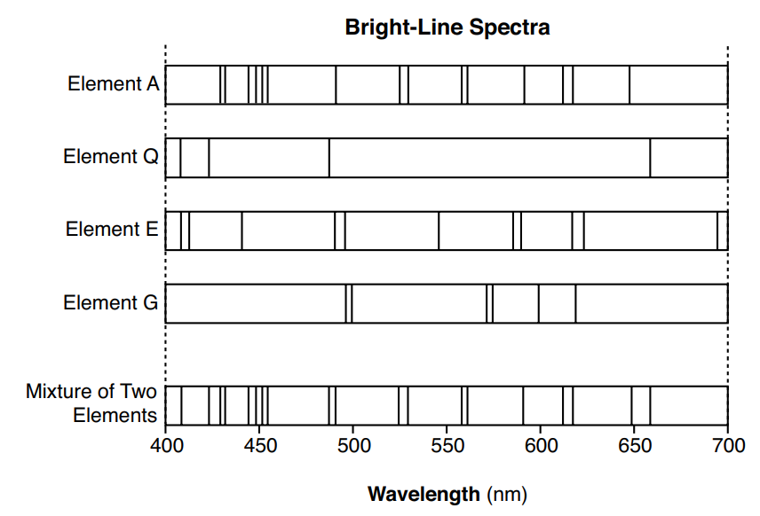
31 Given the bright-line spectra of four elements and the spectrum of a mixture formed from two of these elements Which two elements are present in this mixture? (1) A and QQ (2) A and E (3) G and Q (4) G and E

Slide 63
31 Given the bright-line spectra of four elements and the spectrum of a mixture formed from two of these elements Which two elements are present in this mixture? (1) A and QQ (2) A and E (3) G and Q (4) G and E

Slide 64
32 What is the approximate mass of an atom that has 10 electrons, 10 protons, and 9 neutrons? (1) 10. u (2) 19 u (3) 20. u (4) 29 u

Slide 65
32 What is the approximate mass of an atom that has 10 electrons, 10 protons, and 9 neutrons? (1) 10. u (2) 19 u (3) 20. u (4) 29 u This is what you know… protons = 1 AMU each neutrons = 1 AMU also electrons = have no mass in high school. Here there are 10 p⁺ and 9n° so there are 19 AMU. If you put your finger into table D, the last row is AMU which has a symbol that is the “u”.

Slide 66
33 Which electron configuration represents the electrons of an atom in an excited state? (1) 2-7-3 (2) 2-8-2 (3) 2-8-8-1 (4) 2-8-9-2

Slide 67
33 Which electron configuration represents the electrons of an atom in an excited state? (1) 2-7-3 (2) 2-8-2 (3) 2-8-8-1 (4) 2-8-9-2 All the electron configurations on the periodic table are in the ground state, the lowest possible energy levels. Fingers in boxes now. 2-7-3 (12 e⁻) does not match magnesium in ground state 2-8-2 (12 e⁻) matches magnesium in ground state 2-8-8-1 (19 e⁻) matches potassium in ground state 2-8-9-2 (21 e⁻) matches scandium in the ground state

Slide 68
34 Given information about the naturally occurring isotopes of bromine: Which numerical setup can be used to determine the atomic mass of bromine? (1) (78.92 u)(50.69) + (80.92 u)(49.31) (2) (80.92 u)(50.69) + (78.92 u)(49.31) (3) (78.92 u)(0.5069) + (80.92 u)(0.4931) (4) (80.92 u)(0.5069) + (78.92 u)(0.4931)
Naturally Occurring Isotopes of Bromine
Isotope Notation | Atomic Mass (u) | Natural Abundance (%)
Br-79 | 78.92 | 50.69
Br-81 | 80.92 | 49.31

Slide 69
34 Given information about the naturally occurring isotopes of bromine: Which numerical setup can be used to determine the atomic mass of bromine? (1) (78.92 u)(50.69) + (80.92 u)(49.31) (2) (80.92 u)(50.69) + (78.92 u)(49.31) (3) (78.92 u)(0.5069) + (80.92 u)(0.4931) (4) (80.92 u)(0.5069) + (78.92 u)(0.4931) To do this multiply the atomic mass X percent for each isotope, then sum them up. 1 is wrong, unless you divide the whole thing by 100 2 is wrong, mixing up mass and abundance diagonally
3 is right, mass X percent as a decimal, summed up 4 is wrong, mixing up mass and abundance diagonally
Naturally Occurring Isotopes of Bromine
Isotope Notation | Atomic Mass (u) | Natural Abundance (%)
Br-79 | 78.92 | 50.69
Br-81 | 80.92 | 49.31

Slide 70
35 What is a chemical name of the compound CuS? (1) copper(I) sulfide (2) copper(I) sulfate (3) copper(II) sulfide (4) copper(II) sulfate

Slide 71
35 What is a chemical name of the compound CuS? (1) copper(I) sulfide (2) copper(I) sulfate (3) copper(II) sulfide (4) copper(II) sulfate Here the Cu and S are in a 1:1 ratio, so the ion charges must match up.
Cu might be Cu⁺¹ or Cu⁺² this is trouble, but S is always S⁻², that’s the only anion sulfur can make. To match in a 1:1 ratio that means it must be the Cu⁺² cation which is called: COPPER Roman numeral 2! The “S” is called sulfide -- from the periodic table. This is copper (II) sulfide Put your finger in table E now, Sulfate is SO₄⁻² anion, no oxygen here.

Slide 72
36 Given the equation representing a reaction: 2H_{2(g)} + 2NO_{(g)} → N_{2(g)} + 2H₂O_{(g)} What is the mass of N_{2(g)} produced when 1.0 gram of H_{2(g)} completely reacts with 15.0 grams of 2NO_{(g)} to produce 9.0 grams of H₂O_{(g)}? (1) 7.0 g (2) 14.0 g (3) 25.0 g (4) 28.0 g

Slide 73
36 Given the equation representing a reaction: 2H_{2(g)} + 2NO_{(g)} → N_{2(g)} + 2H₂O_{(g)} What is the mass of N_{2(g)} produced when 1.0 gram of H_{2(g)} completely reacts with 15.0 grams of 2NO_{(g)} to produce 9.0 grams of H₂O_{(g)}? (1) 7.0 g (2) 14.0 g (3) 25.0 g (4) 28.0 g
This is not stoichiometry, it’s the law of conservation of mass.
2H_{2(g)} | + 2NO_{(g)} | → N_{2(g)} | + 2H₂O_{(g)}
Mass of reactants must equal |  | Mass of the products
1.0 gram | 15.O grams | X grams | 9 grams
16.0 grams = X + 9 grams |  | X + 9 grams
7.0 grams = X

Slide 74
37 An atom of which element bonds with an atom of hydrogen to form the most polar bond? (1) bromine (2) chlorine (3) fluorine (4) iodine

Slide 75
37 An atom of which element bonds with an atom of hydrogen to form the most polar bond? (1) bromine (2) chlorine (3) fluorine (4) iodine Make a table, get table S. The greater the difference in electronegativity, the more polar the bond is.
 | Electro- negativity of H | What atom is in this choice? | Electro- negativity of the other atom | Difference in EN values
1 | 2.2 | Br | 3.0 | 0.8
2 | 2.2 | Cl | 3.2 | 1.0
3 | 2.2 | F | 4.0 | 1.8
4 | 2.2 | Zi | 2.7 | 0.5

Slide 76
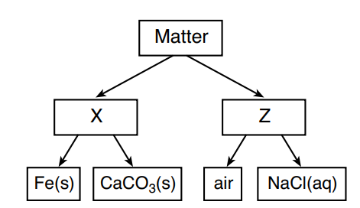
38 Given the diagram representing a classification of matter: Which types of matter are represented by X and Z in the diagram? (1) X is mixture, and Z is substance. (2) X is substance, and Z is mixture. (3) X is element, and Z is compound. (4) X is compound, and Z is element.

Slide 77
38 Given the diagram representing a classification of matter: Which types of matter are represented by X and Z in the diagram? (1) X is mixture, and Z is substance. (2) X is substance, and Z is mixture. (3) X is element, and Z is compound. (4) X is compound, and Z is element. This table is in your notes. There are 2 kinds of matter, pure substances, and mixtures. X are the pure substances (elements & compounds, both homogeneous) Z are the mixtures (homogeneous or heterogeneous) Air and salty water happen to both be homogeneous.

Slide 78
39 Based on Table G, which sample, when added to 100. grams of water and thoroughly stirred, produces a heterogeneous mixture at 20.°C? (1) 20. g of KCl (2) 20. g of KI (3) 80. g of KCl (4) 80. g of KI

Slide 79
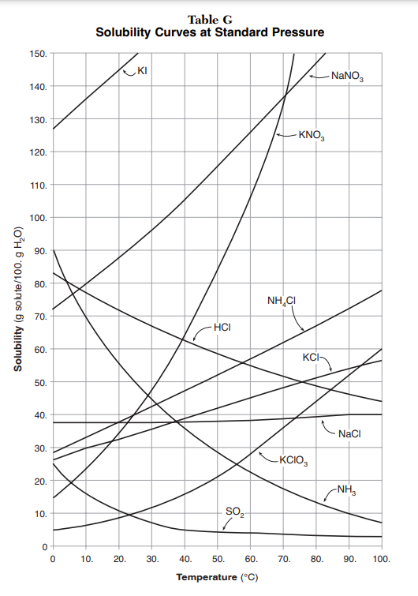
39 Based on Table G, which sample, when added to
100. grams of water and thoroughly stirred, produces a heterogeneous mixture at 20.°C? (1) 20. g of KCl (2) 20. g of KI (3) 80. g of KCl (4) 80. g of KI
 | Choice at 20°C | Can fit this many grams to saturate | This is a saturated or unsaturated solution
1 | 20 g of KCl | ~ 38 g | unsaturated
2 | 20 g of KI | ~ 145 g | unsaturated
3 | 80 g of KCl | ~ 38 g | Saturated with extra undissolved solute
4 | 80 g of KI | ~ 145 g | unsaturated

Slide 80
40 How many milliliters of 1 M HCl_{(aq)} must be diluted with water to make exactly 500 mL of 0.1 M HCl_{(aq)}? (1) 10 mL (2) 50 mL (3) 100 mL (4) 5000 mL

Slide 81
40 How many milliliters of 1 M HCl_{(aq)} must be diluted with water to make exactly 500 mL of 0.1 M HCl_{(aq)}? (1) 10 mL (2) 50 mL (3) 100 mL (4) 5000 mL Use the titration formula to figure this out… back page of reference table
(M_{A})(V_{A}) = (M_{B})(V_{B}) (1 M)(V_{A}) = (0.1 M)(500. mL) divide both sides by the (1 M)
V_{A} = (0.1 M)(500. mL) 50.0 mL 1 M

Slide 82
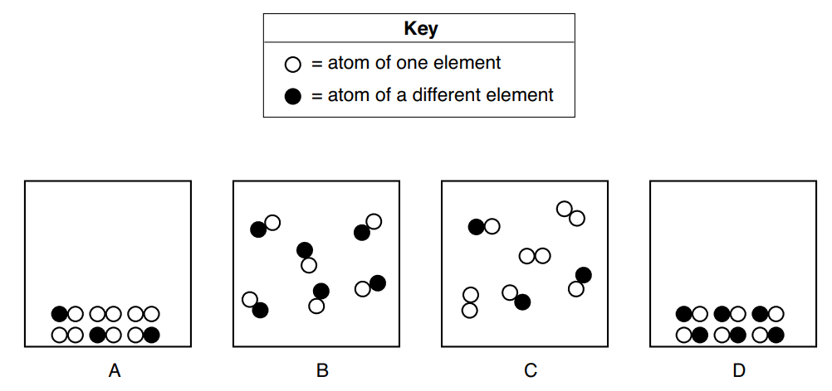
41 Which two particle diagrams represent two different phases of the same compound, only? (1) A and B (2) A and C (3) B and C (4) B and D

Slide 83
41 Which two particle diagrams represent two different phases of the same compound, only? (1) A and B (2) A and C (3) B and C (4) B and D Phases are the SAME STUFF. Compounds mean 2 or more shapes bonded together. Find 2 boxes that that the SAME COMBINATION OF SHAPES in a different pattern. The boxes contain… (to help your thinking) A is SOLID compound and SOLID diatomic element. B is GAS compound only. C is GAS compound and a GAS diatomic element. D is SOLID compound only.

Slide 84
42 A sample of KCl_{(s)} is dissolved in water to form KCl _{(aq)} . When the water in the KCl_{(aq)} is completely evaporated, KCl _{(s)} remains. Which statement describes a property of the KCl _{(s)} after the water evaporated? (1) The KCl _{(s)} becomes a molecular compound. (2) The molar mass of the KCl _{(s)} decreases. (3) The melting point of the KCl _{(s)} is unchanged. (4) The KCl _{(s)} conducts an electric current.

Slide 85
42 A sample of KCl_{(s)} is dissolved in water to form KCl _{(aq)} . When the water in the KCl_{(aq)} is completely evaporated, KCl _{(s)} remains. Which statement describes a property of the KCl _{(s)} after the water evaporated? (1) The KCl _{(s)} becomes a molecular compound. (2) The molar mass of the KCl _{(s)} decreases. (3) The melting point of the KCl _{(s)} is unchanged. (4) The KCl _{(s)} conducts an electric current. Think: This tells you to make salty water, evaporate the water to get only salt again. These are both physical changes, not chemical reactions. KCl is ionic (made up of 2 or more ions). Molar Mass is constant based upon the formula. 3 is right, melting point is a constant. KCl solid can’t conduct electricity, it has no loose mobile ions. KCl_{(AQ)} can conduct electricity.

Slide 86
43 Which statement describes ice and liquid water in a stoppered flask at 0°C at equilibrium? (1) The rate of melting must equal the rate of freezing. (2) The rate of freezing must be greater than the rate of melting. (3) The mass of the ice must equal the mass of the liquid water. (4) The mass of the ice must be greater than the mass of the liquid water.

Slide 87
43 Which statement describes ice and liquid water in a stoppered flask at 0°C at equilibrium? (1) The rate of melting must equal the rate of freezing. (2) The rate of freezing must be greater than the rate of melting. (3) The mass of the ice must equal the mass of the liquid water. (4) The mass of the ice must be greater than the mass of the liquid water. Equilibrium, or dynamic equilibrium means that the rate of the forward reaction or process equals the rate of the reverse. Stuff is happening, but it seems like a steady state. It is steady because what ever happens in the forward is balanced by the exact opposite reverse reaction. At exactly 0°C the ice melts and water freezes solid, at the same rate.

Slide 88
44 Given the equation representing a system at equilibrium in a sealed, rigid container: N_{2(g)} + O_{2(g)} + 182.6 kJ ⇌ 2NO_{(g)} When heat is added to the system, the concentration of N_{2(g)} (1) decreases and the concentration of NO_{(g)} decreases (2) decreases and the concentration of NO_{(g)} increases (3) increases and the concentration of NO_{(g)} increases (4) increases and the concentration of NO_{(g)} decreases

Slide 89
44 Given the equation representing a system at equilibrium in a sealed, rigid container: N_{2(g)} + O_{2(g)} + 182.6 kJ ⇌ 2NO_{(g)} When heat is added to the system, the concentration of N_{2(g)} (1) decreases and the concentration of NO_{(g)} decreases (2) decreases and the concentration of NO_{(g)} increases (3) increases and the concentration of NO_{(g)} increases (4) increases and the concentration of NO_{(g)} decreases Adding heat to this closed system pushes the reaction forward. That means that the amount of N_{2(g)} will decrease. and the amount of O_{2(g)} will decrease and the amount of NO_{(g)} increases.

Slide 90
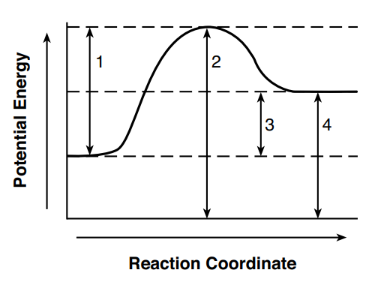
45 Given the potential energy diagram for a reaction: Which numbered interval represents the activation energy of the reaction? (1) 1 (2) 2 (3) 3 (4) 4

Slide 91
45 Given the potential energy diagram for a reaction: Which numbered interval represents the activation energy of the reaction? (1) 1 (2) 2 (3) 3 (4) 4 1 is the Activation energy – the amount of energy required to start this reaction. 2 is the total energy in the activated complex
3 is the ΔH, which is positive here (endothermic) 4 is the total energy in the products formed.

Slide 92
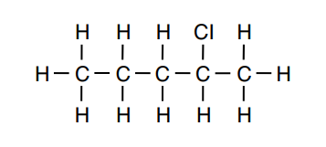
46 Given the formula representing a compound: What is a chemical name for the compound? (1) 2-chloropentene (2) 2-chloropentane (3) 4-chloropentene (4) 4-chloropentane

Slide 93
46 Given the formula representing a compound: What is a chemical name for the compound? (1) 2-chloropentene (2) 2-chloropentane (3) 4-chloropentene (4) 4-chloropentane Five carbons, single bonded = pentane (5 C alkane). On the 2nd carbon atom is bonded a Cl halogen. Say it’s a halocarbon, and tell where that chlorine atom is bonded (to which carbon atom).

Slide 94
47 Which formula represents a saturated organic compound? (1) C₂H₂ (2) C₂H₄ (3) C₃H₄ (4) C₃H₈

Slide 95
47 Which formula represents a saturated organic compound? (1) C₂H₂ (2) C₂H₄ (3) C₃H₄ (4) C₃H₈
Table Q shows us 3 kinds of hydrocarbons, alkanes, alkenes, and alkynes. The first kind have ONLY single bonded carbon atoms. Alkenes have at least one double bond, and alkynes have at least one triple bond.
Because of the single C-C bonds only the alkanes can bond to THE MOST POSSIBLE HYDROGEN atoms. This makes them SATURATED. Table Q uses two carbon molecules as an example.
Find the ALKANE by drawing these, or using the General Formula of C_{n}H_{2n+2} (1) C₂H₂ (2) C₂H₄ (3) C₃H₄ (4) C₃H₈ ALKYNE X ALKENE X ALKYNE X ALKANE ☺

Slide 96
48 The compounds CH₃CH₂CH₂OH and CH₃OCH₂CH₃ have different (1) numbers of carbon atoms per mole (2) numbers of hydrogen atoms per mole (3) functional groups (4) molecular masses

Slide 97
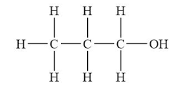
48 The compounds CH₃CH₂CH₂OH and CH₃OCH₂CH₃ have different (1) numbers of carbon atoms per mole (2) numbers of hydrogen atoms per mole (3) functional groups (4) molecular masses Draw, or count atoms to determine that these are ISOMERS, molecules with the same molecular formula but different structures (different functional groups. Both have the same general formula of C₃H₈O. They are 1-propanol (an alcohol) and methyl ethyl ether (an ether).

Slide 98
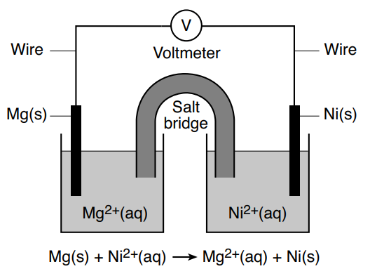
49 The diagram and ionic equation Here represent an operating voltaic cell. Which phrase describes the direction of electron flow in this cell? From… (1) Ni_{(s)} through the wire to Mg_{(s)} (2) Mg_{(s)} through the wire to Ni_{(s)} (3) Ni_{2(aq)} ions through the salt bridge to Mg_{2(aq)} ions (4) Mg_{2(aq)} ions through the salt bridge to Ni_{2(aq)} ions

Slide 99
49 The diagram and ionic equation Here represent an operating voltaic cell. Which phrase describes the direction of electron flow in this cell? From… (1) Ni_{(s)} through the wire to Mg_{(s)} (2) Mg_{(s)} through the wire to Ni_{(s)} (3) Ni_{2(aq)} ions through the salt bridge to Mg_{2(aq)} ions (4) Mg_{2(aq)} ions through the salt bridge to Ni_{2(aq)} ions Here, the Mg and the Ni electrodes are checked on table J. Mg is more reactive, so the Mg will oxidize (lose electrons). Electrons flow from the Mg anode to the Ni cathode via the wire. Electron flow = electricity, that happens in WIRES.

Slide 100
50 Given the equation representing a reaction at equilibrium: NH_{3(aq)} + H₂O_{(L)} ⇌ NH₄⁺_{(aq)} + OH⁻_{(aq)} According to one acid-base theory, which pair are the H donors? (1) NH_{3(aq)} and H₂O_{(L)} (2) NH_{3(aq)} and OH⁻_{(aq)} (3) NH₄⁺_{(aq)} and H₂O_{(L)} (4) NH₄⁺_{(aq)} and OH⁻_{(aq)}

Slide 101
50 Given the equation representing a reaction at equilibrium: NH_{3(aq)} + H₂O_{(L)} ⇌ NH₄⁺_{(aq)} + OH⁻_{(aq)} According to one acid-base theory, which pair are the H donors? (1) NH_{3(aq)} and H₂O_{(L)} (2) NH_{3(aq)} and OH⁻_{(aq)} (3) NH₄⁺_{(aq)} and H₂O_{(L)} (4) NH₄⁺_{(aq)} and OH⁻_{(aq)}
This is hard, and you know how I feel about this theory. In this equation H₂O donates H⁺¹ to NH₃. Choice 2 & 4 have no H₂O, they’re out. In the “reverse” reaction, the NH₄⁺_{(aq)} can donate H⁺¹ cation back to the water.
The NH₃ cannot donate H⁺¹ cations. NH₃ cannot become NH₂⁺¹ so NH₃ is out too. Just ugh! Really, the State of NY wants to trick you with this relatively UNIMPORTANT and OBTUSE theory. I hate them for this stuff. You should too.

Slide 102
51 Identify a metal from Table J that is less active than silver.

Slide 103
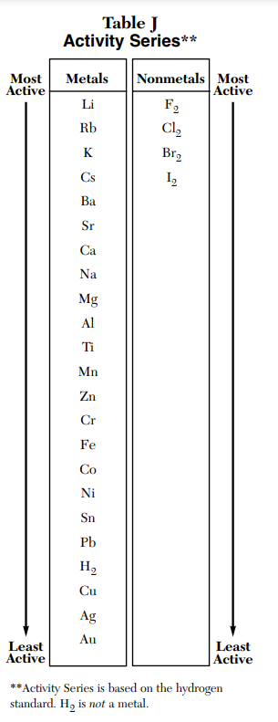
51 Identify a metal from Table J that is less active than silver. Ag is silver, only one metal is less active than silver. The answer is gold, Au.

Slide 104
Base your answers to questions 52 through 54 on the information below and on your knowledge of chemistry. Fluorine, chlorine, bromine, and iodine are located in Group 17 and are called halogens. 52 State, in terms of electrons, why these halogens have similar chemical properties.

Slide 105
Base your answers to questions 52 through 54 on the information below and on your knowledge of chemistry. Fluorine, chlorine, bromine, and iodine are located in Group 17 and are called halogens. 52 State, in terms of electrons, why these halogens have similar chemical properties. All the halogen atoms have 7 valence electrons. When they bond, they must share one valence electron (they make a single bond) or when bonding with metals, they make -1 anions.

Slide 106
Base your answers to questions 52 through 54 on the information below and on your knowledge of chemistry. Fluorine, chlorine, bromine, and iodine are located in Group 17 and are called halogens. 53 Compare the radius of a chlorine atom to the radius of a Cl ion.

Slide 107
Base your answers to questions 52 through 54 on the information below and on your knowledge of chemistry. Fluorine, chlorine, bromine, and iodine are located in Group 17 and are called halogens. 53 Compare the radius of a chlorine atom to the radius of a Cl ion. The chlorine atom has an electron configuration of 2-8-7 The chloride anion has an electron configuration of 2-8-8 All anions are slightly larger than their atoms, the extra valence electron they pick up stretches out the valence (outer) orbital.

Slide 108
Base your answers to questions 52 through 54 on the information below and on your knowledge of chemistry. Fluorine, chlorine, bromine, and iodine are located in Group 17 and are called halogens. 54 In the space in your answer booklet, draw a Lewis electron-dot diagram for an atom of fluorine in the ground state.

Slide 109
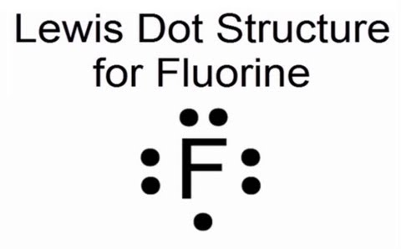
Base your answers to questions 52 through 54 on the information below and on your knowledge of chemistry. Fluorine, chlorine, bromine, and iodine are located in Group 17 and are called halogens. 54 In the space in your answer booklet, draw a Lewis electron-dot diagram for an atom of fluorine in the ground state. Lewis dot diagrams ONLY SHOW valence electrons. Fluorine has an electron configuration of 2-7, so you need seven dots around the “F” symbol, as shown.

Slide 110
A sample of helium gas in a sealed, rigid container is at 240. K and 120. kPa. The temperature is increased to 360. K. 55 State the number of significant figures to which the given pressure is expressed.

Slide 111
A sample of helium gas in a sealed, rigid container is at 240. K and 120. kPa. The temperature is increased to 360. K. 55 State the number of significant figures to which the given pressure is expressed. The pressure here is 120. kPa That has 3 significant figures.

Slide 112
A sample of helium gas in a sealed, rigid container is at 240. K and 120. kPa. The temperature is increased to 360. K. 56 Determine the pressure of the helium at 360. K

Slide 113
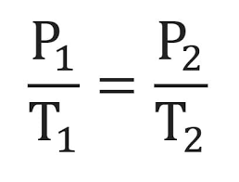
A sample of helium gas in a sealed, rigid container is at 240. K and 120. kPa. The temperature is increased to 360. K. 56 Determine the pressure of the helium at 360. K Rigid container means volume is constant. Use this formula… (240. kPa)(P₂) = (120. kPa)(360. K) P₂ = 180. kPa 3 SF
120. kPa 240. K | = | P₂ 360. K

Slide 114
A sample of helium gas in a sealed, rigid container is at 240. K and 120. kPa. The temperature is increased to 360. K. 57 Show a numerical setup for converting 120. kPa to atmospheres.

Slide 115
A sample of helium gas in a sealed, rigid container is at 240. K and 120. kPa. The temperature is increased to 360. K. 57 Show a numerical setup for converting 120. kPa to atmospheres. For one point, you only need show the set up,. You may finish the math if you want. (you should, see if your answer and units make sense.
120. kPa 1 | X | 1 atm 101.3 kPa | =
1.18 atm with 3 SF

Slide 116
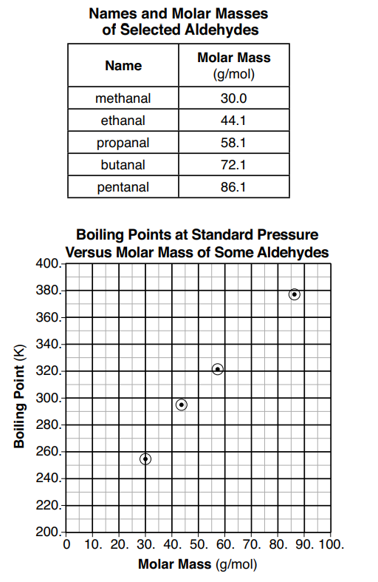
The table and graph below show information about five aldehydes
58 Based on the graph, determine the boiling point of butanal at standard pressure.

Slide 117
The table and graph below show information about five aldehydes
58 Based on the graph, determine the boiling point of butanal at standard pressure. LOOK at top data, butanal has molar mass of 72.1 g/mole. LOOK at the graph below, there is no point at 72.1 g/mol that matches up to a BP. The RED DOT Approximates it at about 343 Kelvin Acceptable answer range is 340 K → 360 K

Slide 118
The table and graph below show information about five aldehydes
59 Determine the mass of 3.00 moles of propanal using the molar mass given in the table.

Slide 119
The table and graph below show information about five aldehydes
59 Determine the mass of 3.00 moles of propanal using the molar mass given in the table. Only the top table is helpful here.
3.00 moles 1 | X | 58.1 g 1 mole | =
174 g with 3 SF

Slide 120
A 100.-mL sample of liquid water is heated in a flask to boiling at 1 atm. As the water boils, some liquid water changes phase to water vapor. This equation represents this change. H₂O_{(L)} + heat → H₂O_{(G)}
60 Describe the change in potential energy of the water molecules that vaporize during boiling.

Slide 121
A 100.-mL sample of liquid water is heated in a flask to boiling at 1 atm. As the water boils, some liquid water changes phase to water vapor. This equation represents this change. H₂O_{(L)} + heat → H₂O_{(G)}
60 Describe the change in potential energy of the water molecules that vaporize during boiling. The water is changing from liquid to gas. Gases have a higher potential energy than their liquids. From the regents exam “key”: The potential energy of the water molecules increases. The water vapor molecules have greater potential energy. The steam has more PE.

Slide 122
A 100.-mL sample of liquid water is heated in a flask to boiling at 1 atm. As the water boils, some liquid water changes phase to water vapor. This equation represents this change. H₂O_{(L)} + heat → H₂O_{(G)}
61 Compare the entropy of the H₂O_{(L)} to the H₂O_{(G)} that is formed.

Slide 123
A 100.-mL sample of liquid water is heated in a flask to boiling at 1 atm. As the water boils, some liquid water changes phase to water vapor. This equation represents this change. H₂O_{(L)} + heat → H₂O_{(G)}
61 Compare the entropy of the H₂O_{(L)} to the H₂O_{(G)} that is formed. Entropy is the measure of disorder in a system. Gases have a higher entropy than liquids. Their molecules are “less organized” and “less contained”. The H₂O_{(G)} has a higher entropy than the H₂O_{(L).}

Slide 124
A 100.-mL sample of liquid water is heated in a flask to boiling at 1 atm. As the water boils, some liquid water changes phase to water vapor. This equation represents this change. H₂O_{(L)} + heat → H₂O_{(G)}
62 Determine the mass of liquid water that vaporizes if 7700 joules of energy is absorbed by the H₂O_{(L)} at 100.°C

Slide 125
A 100.-mL sample of liquid water is heated in a flask to boiling at 1 atm. As the water boils, some liquid water changes phase to water vapor. This equation represents this change. H₂O_{(L)} + heat → H₂O_{(G)}
62 Determine the mass of liquid water that vaporizes if 7700 joules of energy is absorbed by the H₂O_{(L)} at 100.°C This is a “hot phase change” thermochem problem. Write the formula q = mH_{V} 7700 J = (m)(2260 J/g) 3.4 grams = mass with 2 SF

Slide 126
Tritium, hydrogen-3, is a radioisotope. 63 State the number of neutrons in an atom of tritium

Slide 127
Tritium, hydrogen-3, is a radioisotope. 63 State the number of neutrons in an atom of tritium For all atoms, the mass = the sum of protons PLUS neutrons in AMU the atomic number = the number of protons H-3 has a mass of 3 AMU = 3 (p + n)
H atoms have 1 proton, so -1 ( – p ) 2 = neutrons

Slide 128
Tritium, hydrogen-3, is a radioisotope. 64 Complete the nuclear equation in your answer booklet for the decay of tritium by writing a notation for the missing nuclide. This is in the answer booklet…
3 1 | H | → | O -1 | e + | _____

Slide 129
Tritium, hydrogen-3, is a radioisotope. 64 Complete the nuclear equation in your answer booklet for the decay of tritium by writing a notation for the missing nuclide. This is in the answer booklet…
3 1 | H | → | O -1 | e + | 3 2
He

Slide 130
Tritium, hydrogen-3, is a radioisotope. 65 Based on Table N, identify a nuclide that has the same decay mode as tritium, but has a longer half-life.

Slide 131
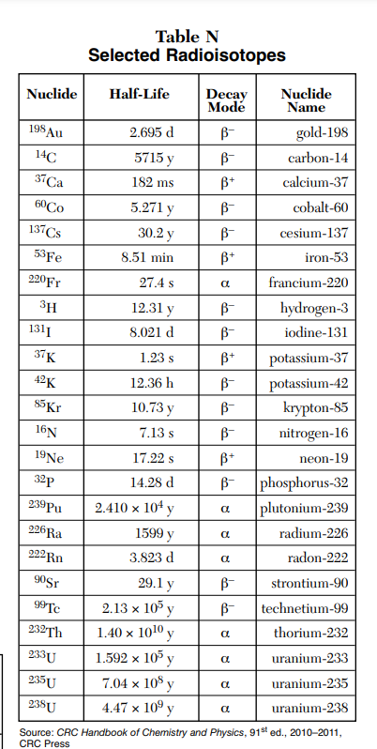
Tritium, hydrogen-3, is a radioisotope. 65 Based on Table N, identify a nuclide that has the same decay mode as tritium, but has a longer half-life. H-3 has a decay mode of beta decay and a half life of 12.31 years. (put some fingers in boxes) The answer must have BETA DECAY, but a half life longer than 12.31 years. Any of these is good: ¹⁴C, ¹³⁷Cs, ⁹⁰S, ⁹⁹Tc

Slide 132
Phosphorus combines with oxygen to form an oxide that reacts with water to produce phosphoric acid, which is an important industrial compound used to produce fertilizers. An unbalanced equation for the production of phosphoric acid is shown below. P₄O_{10(S)} + H₂O_{(L)} → H₃PO_{4(AQ)} + energy
66 Balance the equation in your answer booklet for the production of phosphoric acid, using the smallest whole-number coefficients. The answer booklet provides you with… ___P₄O_{10(S)} + ___H₂O_{(L)} → ___H₃PO_{4(AQ)}

Slide 133
P₄O_{10(S)} + H₂O_{(L)} → H₃PO_{4(AQ)} + energy
66 Balance the equation in your answer booklet for the production of phosphoric acid, using the smallest whole-number coefficients. The answer booklet provides you with… ___P₄O_{10(S)} + 6 H₂O_{(L)} → 4 H₃PO_{4(AQ)} This is balanced with “just” the 6 and 4, but you could also do this: _____________________________________________ 1 P₄O_{10(S)} + 6 H₂O_{(L)} → 4 H₃PO_{4(AQ)} and put the “1” in front of the P₄O₁₀

Slide 134
Phosphorus combines with oxygen to form an oxide that reacts with water to produce phosphoric acid, which is an important industrial compound used to produce fertilizers. An unbalanced equation for the production of phosphoric acid is shown below. P₄O_{10(S)} + H₂O_{(L)} → H₃PO_{4(AQ)} + energy 67 Write the empirical formula of the solid reactant in the equation. That’s the P₄O_{10(S)} which has a 4:10 ratio. That can be “reduced” to a 2:5 ratio; The (dumb ☺ ) empirical formula is P₂O₅

Slide 135
Phosphorus combines with oxygen to form an oxide that reacts with water to produce phosphoric acid, which is an important industrial compound used to produce fertilizers. An unbalanced equation for the production of phosphoric acid is shown below. P₄O_{10(S)} + H₂O_{(L)} → H₃PO_{4(AQ)} + energy 68 Show a numerical setup for calculating the percent composition by mass of phosphorus in P₄O₁₀ (formula mass 283.89 u).

Slide 136
P₄O_{10(S)} + H₂O_{(L)} → H₃PO_{4(AQ)} + energy 68 Show a numerical setup for calculating the percent composition by mass of phosphorus in P₄O₁₀ (formula mass 283.89 u).
Molar Mass | Percent Comp by Mass
P₄O₁₀
P 4 x 31 g = 124 g | P 124g/284 g X 100% = 44% | ← is the answer in red
O 10 x 16 g = 160 g | O 160g/284g X 100% = 56%
Molar mass = 284 g/mole | Check = 100% | Do the math to “check”

Slide 137
P₄O_{10(S)} + H₂O_{(L)} → H₃PO_{4(AQ)} + energy 69 Determine the oxidation state of phosphorus in the phosphoric acid.

Slide 138
69 Determine the oxidation state of phosphorus in the phosphoric acid. This is the phosphoric acid → H₃PO_{4(AQ)} check on table K if you don’t remember, we can wait. Put your finger into the box to be sure.
H₃PO₄ Atoms all have selected oxidation states. H has 2 choices, but O must be -2 Four oxygen atoms sum up to -8 oxidation. That means the 3 H’s + the P must sum up to +8 for the molecule to sum to zero
If we use: H⁺¹ + H ⁺¹ + H ⁺¹ + P ⁺⁵ = +8 (perfect) Phosphorous is +5

Slide 139
Calcium oxide, CaO, also known as lime, is an important industrial chemical. Lime can be obtained by the heating of limestone, which is mainly calcium carbonate, CaCO₃.
This is the equation representing the reaction for the production of lime: CaCO_{3(S)} + heat → CaO_{(S)} + CO_{2(G)}
70 State the solubility of limestone in water.

Slide 140
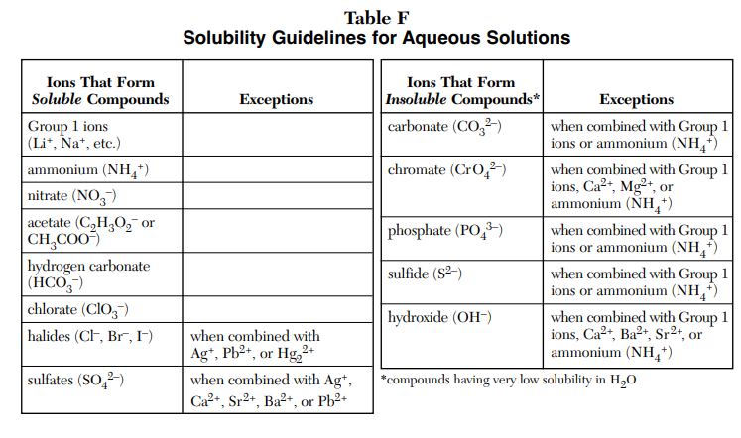
Calcium oxide, CaO, also known as lime, is an important industrial chemical. Lime can be obtained by the heating of limestone, which is mainly calcium carbonate, CaCO₃.
This is the equation representing the reaction for the production of lime: CaCO_{3(S)} + heat → CaO_{(S)} + CO_{2(G)}
70 State the solubility of limestone in water. This is a table F problem, is calcium carbonate soluble in water? Carbonates make insoluble compounds in water, except with Group 1 metal cations, or NH₄⁺¹. Calcium is in group 2 Calcium carbonate is INSOLUBLE in water

Slide 141
Calcium oxide, CaO, also known as lime, is an important industrial chemical. Lime can be obtained by the heating of limestone, which is mainly calcium carbonate, CaCO₃.
This is the equation representing the reaction for the production of lime: CaCO_{3(S)} + heat → CaO_{(S)} + CO_{2(G)}
71 State evidence from the equation that the reaction to form lime is endothermic You could say this at least three different ways, either are okay: The energy term is on the reactant side of the equation. Heat is on the left side of the equation. Heat must be added to decompose limestone and form lime.

Slide 142
Calcium oxide, CaO, also known as lime, is an important industrial chemical. Lime can be obtained by the heating of limestone, which is mainly calcium carbonate, CaCO₃.
This is the equation representing the reaction for the production of lime: CaCO_{3(S)} + heat → CaO_{(S)} + CO_{2(G)}
72 Identify the noble gas that has atoms in the ground state with the same electron configuration as the calcium ion, in the ground state, in the CaCO₃. CaCO₃ forms from the Ca⁺² cation and the CO₃⁻² anion in a 1:1 ratio, Calcium has a 2-8-8-2 electron configuration as an atom. It “loses” 2 valence electrons to become the Ca⁺² cation. That means Ca⁺² has a 2-8-8 electron configuration, matching ARGON

Slide 143
Calcium oxide, CaO, also known as lime, is an important industrial chemical. Lime can be obtained by the heating of limestone, which is mainly calcium carbonate, CaCO₃.
This is the equation representing the reaction for the production of lime: CaCO_{3(S)} + heat → CaO_{(S)} + CO_{2(G)}
73 State the type of chemical bonding in a sample of CaO. CaO is calcium oxide formed when the calcium cation and the oxide anion come together (very tightly) in a 1:1 ratio, in an IONIC BOND Criss cross the ion charges to get Ca⁺² and O⁻² → CaO

Slide 144
During a laboratory activity, a student places 20.0 mL of HCl_{(AQ)} of unknown concentration into a flask. The solution is titrated with 0.10 M KOH_{(AQ)} until the HCl_{(AQ)} is exactly neutralized.
At the end of the titration, the volume of KOH_{(AQ)} added is 42.0 mL. During the laboratory activity appropriate safety equipment was used and safety procedures were followed.
74 Compare the number of moles of H⁺¹_{(AQ)} ions to the number of moles of OH⁻¹_{(AQ)} ions in the titration mixture when the HCl_{(AQ)} is exactly neutralized by the KOH_{(AQ)}.

Slide 145
During a laboratory activity, a student places 20.0 mL of HCl_{(AQ)} of unknown concentration into a flask. The solution is titrated with 0.10 M KOH_{(AQ)} until the HCl_{(AQ)} is exactly neutralized.
At the end of the titration, the volume of KOH_{(AQ)} added is 42.0 mL. During the laboratory activity appropriate safety equipment was used and safety procedures were followed.
74 Compare the number of moles of H⁺¹_{(AQ)} ions to the number of moles of OH⁻¹_{(AQ)} ions in the titration mixture when the HCl_{(AQ)} is exactly neutralized by the KOH_{(AQ)}.

Slide 146
During a laboratory activity, a student places 20.0 mL of HCl_{(AQ)} of unknown concentration into a flask. The solution is titrated with 0.10 M KOH_{(AQ)} until the HCl_{(AQ)} is exactly neutralized.
At the end of the titration, the volume of KOH_{(AQ)} added is 42.0 mL. During the laboratory activity appropriate safety equipment was used and safety procedures were followed.
75 Determine the concentration of the HCl_{(AQ)} solution using the titration data.

Slide 147
During a laboratory activity, a student places 20.0 mL of HCl_{(AQ)} of unknown concentration into a flask. The solution is titrated with 0.10 M KOH_{(AQ)} until the HCl_{(AQ)} is exactly neutralized.
At the end of the titration, the volume of KOH_{(AQ)} added is 42.0 mL. During the laboratory activity appropriate safety equipment was used and safety procedures were followed.
75 Determine the concentration of the HCl_{(AQ)} solution using the titration data.

Slide 148
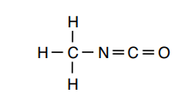
A scientific sampling instrument landed on a comet. Four of the organic compounds detected on the comet are methyl isocyanate, propanone, propanal, and ethanamide. The structural formula for methyl isocyanate is shown below: 76 Identify the element in these four compounds that makes them organic compounds.

Slide 149
A scientific sampling instrument landed on a comet. Four of the organic compounds detected on the comet are methyl isocyanate, propanone, propanal, and ethanamide. The structural formula for methyl isocyanate is shown below: 76 Identify the element in these four compounds that makes them organic compounds.

Slide 150
A scientific sampling instrument landed on a comet. Four of the organic compounds detected on the comet are methyl isocyanate, propanone, propanal, and ethanamide. The structural formula for methyl isocyanate is shown below: 77 Write the names of the two organic compounds detected on the comet that are isomers of each other.

Slide 151
A scientific sampling instrument landed on a comet. Four of the organic compounds detected on the comet are methyl isocyanate, propanone, propanal, and ethanamide. The structural formula for methyl isocyanate is shown below: 77 Write the names of the two organic compounds detected on the comet that are isomers of each other.

Slide 152
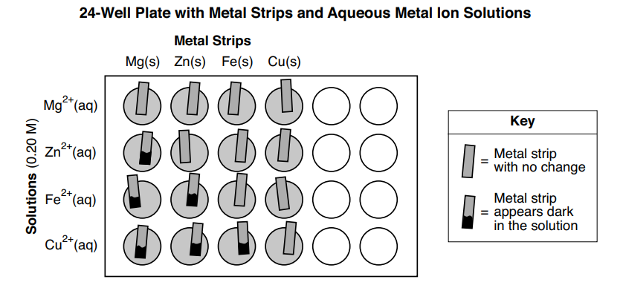
During a laboratory activity appropriate safety equipment is used and safety procedures are followed. A student tests samples of four different metals using 0.20 M aqueous metal ion solutions of the same four metals. The student uses a 24-well plate as the reaction container for the different metal and solution combinations. Before placing a metal strip in each solution, the student cleans the surface of the metal strip with sandpaper. The 24-well plate diagram below shows the setup and results of the investigation. In each vertical column, the metal strips are all the same metal. For each horizontal row, all of the solutions contain the same type of metal ion. 78 Using the results of the student’s investigation, state evidence that zinc metal is more active than copper metal.

Slide 153
78 Using the results of the student’s investigation, state evidence that zinc metal is more active than copper metal. Several answers are possible: 1. The Cu metal is less active than Zn metal since Cu metal does not react with any of the solutions and Zn metal reacts with two solutions.
2. Zinc metal is more chemically active than copper metal, because zinc reacts with Fe⁺² ions and copper does not. 3. The Zn_{(S)} reacted with the Cu⁺²_{(AQ)}, but the Cu_{(S)} does not react with the Zn⁺²_{(AQ)}. 4. Zinc is dark in more solutions. Note: Do not allow credit for a response based on Table J.

Slide 154
79 Compare the number of electrons lost by the Mg_{(S)} placed in the Zn⁺²_{(AQ)} solution to the number of electrons gained by the Zn⁺²_{(AQ)}

Slide 155
79 Compare the number of electrons lost by the Mg_{(S)} placed in the Zn⁺²_{(AQ)} solution to the number of electrons gained by the Zn⁺²_{(AQ)} No math here, redox or oxidation – reduction requires that the electron transfer to be perfect, every single electron is accounted for. The number of electrons lost, or OXIDIZED, is equal to the number of electrons “gained” or REDUCED. The number of electrons lost and gained are equal.

Slide 156
80 Write a balanced, half-reaction equation for the reduction of the copper ions.

Slide 157
80 Write a balanced, half-reaction equation for the reduction of the copper ions. ½ ox : Cu⁺² + 2e– → Cu° Note: Do not allow credit for the e without the minus sign (–).

Slide 158
81 State why the student was instructed to clean the surface of the metal strips with sandpaper before placing each strip into an aqueous metal ion solution.

Slide 159
81 State why the student was instructed to clean the surface of the metal strips with sandpaper before placing each strip into an aqueous metal ion solution. Many things might be said, these 3 are from the “key” 1 Sanding the surface of the metal strip exposes unoxidized metal for a possible reaction.
2 Cleaning the metal provides a fresh metal surface for the reaction. 3 If a reaction will occur, it is more likely with pure metal available.

Slide 160
Tetrachloromethane, CCl₄, was used as a dry-cleaning solvent until it was banned for this use in the U.S. in 1970 due to its toxicity. This solvent was replaced in many dry-cleaning processes by tetrachloroethene, C₂Cl₄. Another currently available alternative dry-cleaning solvent is 1-bromopropane. The table below shows the boiling points of these solvents. 82 Explain, in terms of intermolecular forces, why tetrachloroethene has a higher boiling point than tetrachloromethane.
Boiling Points of Three Compounds at 1 atm | d
Name | Boiling Point ( °C )
tetrachloromethane | 76.8
tetrachloroethene | 121.3
1-bromopropane | 71.1

Slide 161
Tetrachloromethane, CCl₄, was used as a dry-cleaning solvent until it was banned for this use in the U.S. in 1970 due to its toxicity. This solvent was replaced in many dry-cleaning processes by tetrachloroethene, C₂Cl₄. Another currently available alternative dry-cleaning solvent is 1-bromopropane. The table below shows the boiling points of these solvents. 82 Explain, in terms of intermolecular forces, why tetrachloroethene has a higher boiling point than tetrachloromethane. Higher BP are from stronger intermolecular attractions. Tetrachlorethene has the highest BP in the data table because it has the strongest intermolecular attractions of these 3 compounds. (also known as intermolecular forces)
Boiling Points of Three Compounds at 1 atm | d
Name | Boiling Point ( °C )
tetrachloromethane | 76.8
tetrachloroethene | 121.3
1-bromopropane | 71.1

Slide 162
83 Draw a structural formula for 1-bromopropane.

Slide 163
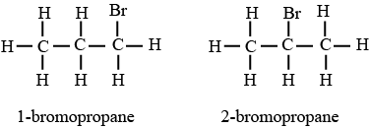
83 Draw a structural formula for 1-bromopropane. This one is correct. This one is WRONG. Bromine is attached to Bromine is attached to the 1st carbon atom. the 2nd carbon atom.

Slide 164
When a neutron is absorbed by a uranium-235 nucleus, the nucleus can split. One possible nuclear reaction is represented by the balanced equation below. In this reaction, the products have a mass that is 0.180 u less than the mass of the reactants.
84 Compare the energy released per gram of reactant during this reaction to the energy released per gram of reactant in a chemical reaction

Slide 165
When a neutron is absorbed by a uranium-235 nucleus, the nucleus can split. One possible nuclear reaction is represented by the balanced equation below. In this reaction, the products have a mass that is 0.180 u less than the mass of the reactants.
84 Compare the energy released per gram of reactant during this reaction to the energy released per gram of reactant in a chemical reaction Nuclear reactions release more energy/gram than a chemical reaction. Nuclear reactions release more energy. Chemical reaction releases less energy.

Slide 166
85 Determine the time required for an 8.00-mg sample of Sr-90 to decay until only 2.00 mg of the sample remains unchanged.

Slide 167
85 Determine the time required for an 8.00-mg sample of Sr-90 to decay until only 2.00 mg of the sample remains unchanged. It will take 2 half lives, which in Table N are 29.1 years each, so it will take 2 x 29.1 years = 58.2 years
TIME 1 HALF 2 HALF 3 HALF 4 HALF 0 LIFE LIFE LIFE LIFE
8.00 mg 4.00 mg 2.00 mg 1.00 mg 0.50 mg present unchanged unchanged unchanged unchanged The ANSWER

